Slide 1

Welcome
Notes:
Topic: Flexible Thinking
Time: 30 minutes
Purpose of training evolution: Sailors will explore the concept of flexible thinking and its role in navigating challenging situations effectively.
Expected outcome of training evolution: Sailors will learn practical flexible thinking tools to identify and reframe unhelpful thoughts.
Safety: Inform Sailors of safety hazards in the training environment. For some topics, Sailors should be informed if there is a designated person to talk to if the Sailor feels compelled to leave the training.
Facilitator Actions:
Display slide.
Greet Sailors.
Introduce yourself and give any background on yourself that might be of interest.
Establish credibility.
Facilitator Instructions:
The slide deck acts as a guide to present a facilitated discussion that may include activities.
Best practice: Use the slide to develop interest in the subject matter. Do not read the slides word for word. The Sailors should be able read the text and understand the messaging presented in the graphics.
Facilitator notes are available for each slide to help the Facilitator deliver the topic.
Best practice: Use the Slide Show view to ensure the Facilitator notes are viewable.
The Facilitator notes are divided into general instructions for Facilitator Actions (mechanics of facilitation) and the Facilitator Content (Inform, Discuss, Perform, and Reference).
Best practice for Inform: Present facts, concepts, and procedures. Depending on the subject matter, these may be written as suggested talking points or scripted material (denoted by quotation marks).
Best practice for Discuss: Conduct large-group question and answer sessions or large-group, Facilitator-led activities. Depending on the subject matter, these may be written as questions with expected answers or scripted activities.
Best practice for Perform: Facilitate small-group, scenario-based or procedural activities. Depending on the subject matter, these may be written with specific actions the Sailors will take or general ways for the Facilitator to monitor the activities. The Facilitator will be provided with expected outcomes to ensure Sailors leave training with correct information.
Best practice for Reference: This is for Facilitator use only.

Slide 2
Introduction
Warrior Toughness
MIND • BODY • SPIRIT
Flexible Thinking
Notes:
Facilitator Actions:
Display slide.
Introduce topic.
Let Sailors know that they can leave the discussion if they have to for their own well-being.
Ensure that misinformation is corrected immediately.
Monitor the discussions of the Sailors throughout the training event.
Facilitator Content:
Inform:
To build Warrior Toughness, Sailors will explore the concept of flexible thinking and its role in navigating challenging situations effectively.
Sailors will learn practical flexible thinking tools to identify and reframe unhelpful thoughts.

Slide 3
Learning Objective
Use flexible thinking to weigh possible actions, adapt, and correctly respond in challenging situations.
Notes:
Facilitator Actions:
Display slide.
Neither Sailors nor Facilitator should read the objective out loud.
Facilitator Content: N/A

Slide 4
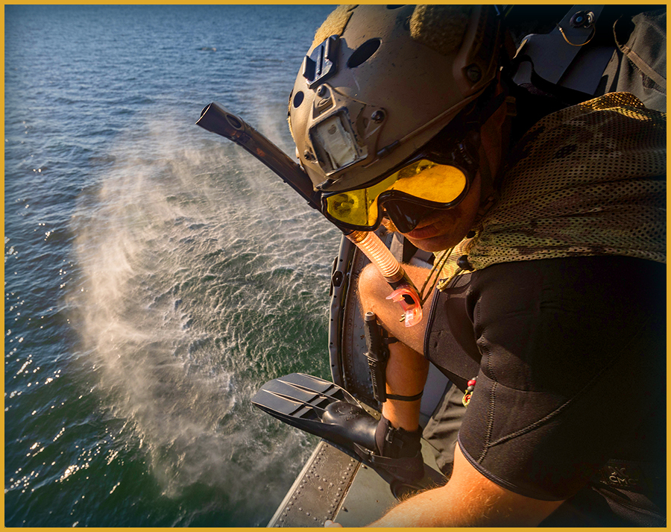
Flexible Thinking
When orders shift or unexpected challenges arise, do you adapt quickly, find alternatives, or feel stuck?
"If you want to change the world, you must be your very best in the darkest moments.“ McRaven, William H., “University of Texas at Austin 2014 Commencement Address.”
Notes:
Facilitator Actions:
Display slide.
Discuss how graphic relates to topic.
Monitor the discussions of the Sailors.
Facilitator Content:
Inform:
When orders shift or unexpected challenges arise, do you adapt quickly, find alternatives, or feel stuck?
Discuss:
Conduct a brief discussion or poll based on the question above.
Inform:
Our thoughts impact how we feel and behave at any given time, which ultimately affects our performance.
Reference:
McRaven, William H., “University of Texas at Austin 2014 Commencement Address.”

Slide 5
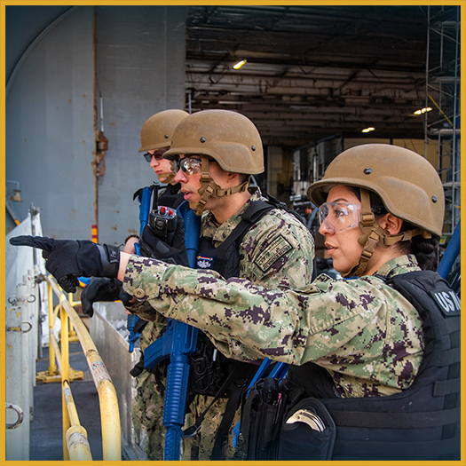
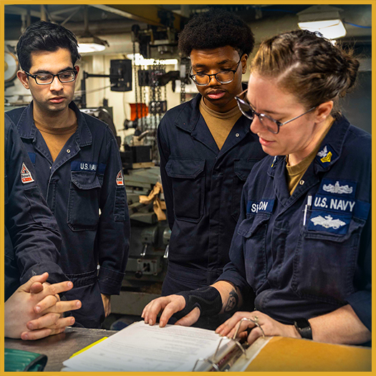
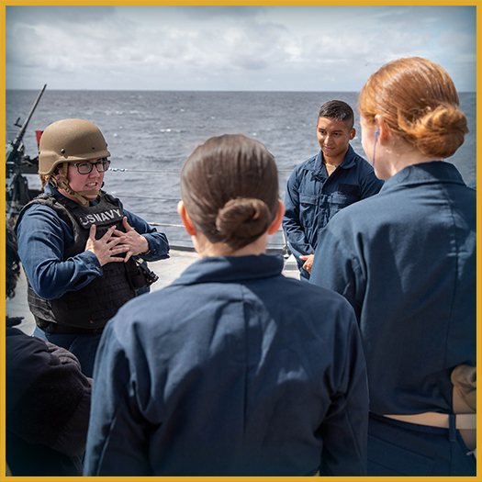
What Is Flexible Thinking?
Flexible thinking is the ability to think about a situation in a new or different way.
Notes:
Facilitator Actions:
Display slide.
Discuss how graphics relate to topic.
Monitor the discussions of the Sailors.
Facilitator Content:
Inform:
What is flexible thinking? Flexible thinking occurs when we do the following:
Think about situations or experiences with a positive perspective.
Remain open to multiple possibilities, ideas, or thoughts.
Consider other points of view and opinions.

Slide 6
Flexible Thinking Activity
How can you apply the concepts in this video to your
everyday life?
CLICK TO DOWNLOAD VIDEO
(DVIDS VIDEO)
Open in your browser to download from DVIDS
Notes:
Facilitator Actions:
Display slide.
Select Play or use the Enter key to view the video.
Use the ESC key to return to the smaller size.
Let Sailors know where they can locate references.
Monitor the discussions of the Sailors.
Facilitator Content:
Expected outcomes: Sailors will experience firsthand how differing perspectives can challenge what feels natural to them, highlighting the importance of flexibility and the ability to shift viewpoints effectively.
Inform:
This video shows people clasping their hands and folding their arms.
Discuss:
Directions for Exercise: Get a Grip
Ask the Sailors to clasp their hands so that their fingers interlock. Ask the Sailors to note which thumb is on top. Ask the Sailors to raise their hands if they had their left thumb on top. Tell the Sailors that they can unclasp their hands to raise their hands. Usually, approximately half the group raises their hands, regardless of right- or left-handedness. How many had their right thumb on top? Now, note the percentage raising their hands. Note that what feels natural for some is not natural for others.
Relate that idea to the idea of our perceptions. For example, we think people should see things the same way we do and through this hands-on exercise we realize this is not true. Now have the Sailors shift their fingers in the opposite way. Make sure they clasp all their fingers differently, not just the thumbs.
Ask the Sailors how this feels. You likely will get responses such as: weird, strange, and uncomfortable. Apply this exercise as a metaphor for the importance of how we often need to shift our thinking ever so slightly, even though it might seem unnatural, to look at a situation in a different way.
This can be a visual reminder of the importance of being flexible and changing one’s perspective, and to realize that some people may struggle with something that might come naturally to you.
Directions for Exercise: Arm Folding
Ask the Sailors to fold their arms, noting which arm is on top. Ask for hands (urging them to let go first, of course) for those who had their right arm on top. Note that many Sailors who began with their right thumb on top in the first exercise will have the opposite arm on top in this exercise.
As in the first exercise, the group likely will be roughly evenly split. Ask the Sailors to fold their arms the other way. They may claim it feels even weirder than in the first exercise, which gives you the opportunity to re-emphasize that what feels natural to some may not for others.
We often assume inaccurately that others are innately more like us than they really are, which can be a frustrating misperception.

Slide 7
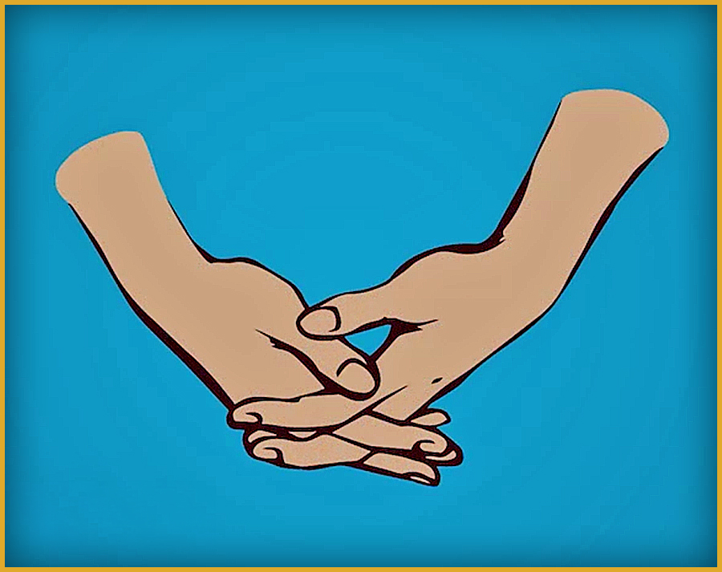
Flexible Thinking Activity (continued)
How did this exercise make you feel?
Were you surprised by this exercise?
Did you learn something about yourself through this exercise?
How did it feel to flex or shift your fingers? Easy or difficult? Why?
Notes:
Facilitator Actions:
Display slide.
Monitor the discussions of the Sailors.
Allotted time for activity: 5 minutes.
Facilitator Content:
Expected outcomes: Sailors will experience firsthand how differing perspectives can challenge what feels natural to them, highlighting the importance of flexibility and the ability to shift viewpoints effectively.
Discuss:
How did this exercise make you feel?
Were you surprised by this exercise?
Did you learn something about yourself through this exercise?
How did it feel to flex or shift your fingers? Easy or difficult? Why?

Slide 8

Self-Talk Model
SITUATION
BEHAVIORS
AWARENESS
THOUGHTS
EMOTION
PERFORMANCE
BEHAVIOR
THOUGHT
EMOTIONS
Notes:
Facilitator Actions:
Display slide.
Discuss how graphic relates to topic.
Monitor the discussions of the Sailors.
Facilitator Content:
Inform:
The Self-Talk Model shows how the thoughts we tell ourselves influence our emotions and behaviors. Flexible thinking helps us recognize when our self-talk is unhelpful or overly rigid and then adjusts it to be more balanced and constructive.
Thoughts, emotions, and behaviors all occur in response to internal or external stressors and each one can trigger the next, forming a loop. Sometimes this loop is helpful but at other times, it is unhelpful.
The key to altering the loop is awareness of patterns and associations between thoughts, emotions, and behaviors.
Recognize patterns in the following loop to find ways to intervene to optimize our performance:
Situation: Anything that happens in our environment. Situations are usually outside of our direct control but can be influenced by behaviors.
Thought: What we think or believe about a situation. How we interpret an event or situation. Thoughts also shape the quality and intensity of feelings and influence behaviors. Thoughts are usually a full sentence.
Emotion: Our mood or how we feel about a situation or event. Emotions are not necessarily based on logic but are influenced by our thoughts and beliefs about a situation. Emotions may reflect a learned style of thinking or be related to a situation or to an event. Sustained negative emotions may lead to negative mood states, such as, depression, chronic anger, or anxiety. Emotions or feelings are usually one word.
Behavior: Our outward response or actions in response to a situation, which includes our internal physiological behavior, such as hyper-arousal, rapid heartbeat, and palpitations.
Awareness: A crucial step to changing our thoughts is being mindful of our thoughts, feelings, and behaviors, and how each feed into each other.

Slide 9
Not All Thoughts Are Helpful
How have you seen a cognitive distortion or logical fallacy interfere with optimal performance in a real-life situation?
Cognitive Distortions are inaccurate or irrational patterns of thinking that negatively affect how we perceive ourselves, others, and the world.
Jumping to Conclusions – Mind Reading: Drawing conclusions about what another person is thinking or believes without hearing directly from them.
E.g., "My chief believes I'm underperforming my potential."
Emotional Reasoning: Assuming something is fact because you feel a certain way.
E.g., "I feel nervous and embarrassed, so I must be messing up and making mistakes."
Doom-Thinking: Believing the "worst-case scenario" is the most likely outcome.
Labeling: Using one characteristic or behavior to define an entire person.
Logical Fallacies are flaws in reasoning or argument that lead to invalid conclusions.
Anecdotal: Using personal experience or an isolated example instead of a valid argument, especially to dismiss statistics.
Texas Sharpshooter: Cherry-picking data or evidence to fit an argument, or finding a pattern to fit a belief.
Loaded Question: Asking a question that has an assumption built into it, so it can't be answered without appearing guilty.
Bandwagon: Appealing to popularity or the fact that many people engage in or believe something as a way to validate its truth, value, or credibility.
Notes:
Facilitator Actions:
Display slide.
Discuss how graphic relates to topic.
Monitor the discussions of the Sailors.
Facilitator Content:
Inform:
Our brains are wired to use different shortcuts and “heuristics” to save energy. Heuristics involve or serve as an aid to learning, discovery, or problem-solving through experimental methods, particularly by using trial and error.
For example, when driving to work, you sometimes arrive without remembering the details of the drive, or you choose the shortest line at the grocery store because it feels like the quickest option. Heuristics simplify decision-making and conserve mental energy.
However, when we rely on these shortcuts, especially without realizing, it can lead to walking into a hazard that can negatively impact our performance through negative impacts on our emotions, decisions, and behaviors.
In the correct situations, self-talk can be helpful, but these types of self-talk can lead to a decrease in self-confidence and poor performance if they dominate your thinking.
Thoughts become unhelpful when we do the following:
Get hooked on rigid thinking. Rigid thinking is intolerant, non-accommodating, and restrictive, and typically increases one's stress level.
Get stuck in a battle with something beyond our control.
Use unhealthy coping skills, for example, avoidance, to get rid of uncomfortable thoughts.
Blame others rather than accept personal responsibility for our actions.
Increase awareness of self-talk in the following ways:
Through reflection, we identify moments when we experienced strong emotions, exhibited poor, or sub-optimal behavior, and examine the thoughts we had at the time.
Through awareness, we recognize patterns in our thinking and understand how they relate to performance.
Discuss:
Looking at the examples of cognitive distortions and logical fallacies, discuss a time you have seen one of these interfere with optimal performance.
Which hazardous thinking pattern was used?
How did it interfere?
How was it addressed?
How would you improve performance?

Slide 10



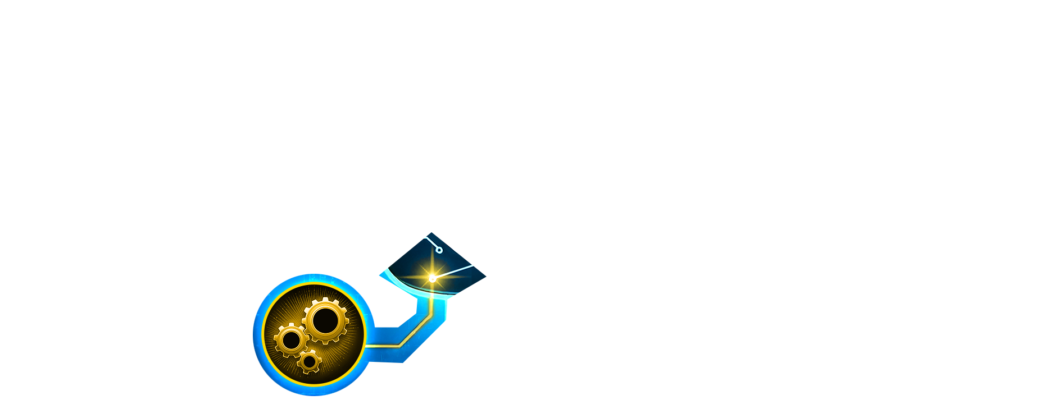

The Power of Neuroplasticity
How can you apply the concepts in this video to your
everyday life?
Notes:
Facilitator Actions:
Display slide.
Discuss how graphic relates to topic.
Navigate to the YouTube path provided.
Monitor the discussions of the Sailors.
Facilitator Content:
Reference Path:
Sentis. “Neuroplasticity.” Educational video, 2:03. https://www.youtube.com/watch?v=ELpfYCZa87g
Inform:
This video explains how neuroplasticity identifies, challenges, and reshapes unhelpful thought patterns in our brain.
Discuss:
What are your reactions to this video?
Is it news to you that an old dog can learn new tricks?
How can you apply the concepts in this video to your everyday life?

Slide 11
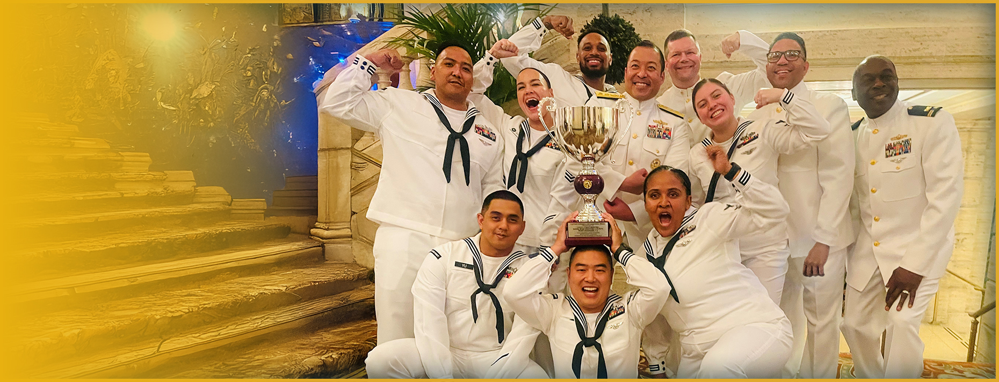
Retrain Your Brain for Optimism
What tools can you use to build optimism?
Altruism
Gratitude
Positive Self-Talk
Self-Compassion
Growth Mindset
Notes:
Facilitator Actions:
Display slide.
Discuss how graphic relates to topic.
Monitor the discussions of the Sailors.
Facilitator Content:
Discuss:
What tools can you use to build optimism?
Do you practice gratitude regularly? What have you noticed from practicing it over time?
Do you talk to yourself or others more compassionately?
Inform:
Optimism is maintaining positive thoughts, beliefs, attitudes, emotions, and expectations regarding life, and being flexible about change. Optimism develops hope and positive expectations when under periods of stress.
An important aspect of optimism is maintaining a sense of perspective and humor and recognizing that difficult situations are temporary.
Retrain your brain to flip negatives into positives by practicing the following:
Altruism: Enhance your self-esteem by helping others. This can be something as small as paying for the coffee of the person behind you in the drive-through.
Gratitude: Retrain your brain to notice the good things that are happening around you.
Positive self-talk: Be your own cheerleader. Notice what you automatically say to yourself inside your own head when you make a mistake. Is it harsh and critical, or encouraging?
Self-compassion: Self-compassion is more motivating than shame and guilt. It is not making excuses but rather recognizing why you did something and how you can change it going forward.
Growth mindset: View challenges as opportunities to stretch your abilities rather than as obstacles to avoid.

Slide 12

Call to Action
Build Warrior Toughness by using flexible thinking!
Notes:
Facilitator Actions:
Display slide.
Review topics discussed and ask if there are any questions.
Check Sailor comprehension by providing review questions and/or problems.
Discuss how the call to action supports and encourages Sailors’ post training.
Relate call to action to Warrior Toughness.
Facilitator Content: N/A

Slide 13
References
Tools and Resources
McRaven, William H., “University of Texas at Austin 2014 Commencement Address.” Speech, University of Texas at Austin, May 17, 2014.
Sentis. “Neuroplasticity.” Educational video, 2:03.
Notes:
Facilitator Actions:
Display slide.
Facilitator Content:
Inform:
Identify tools.
Identify resources.

Slide 14
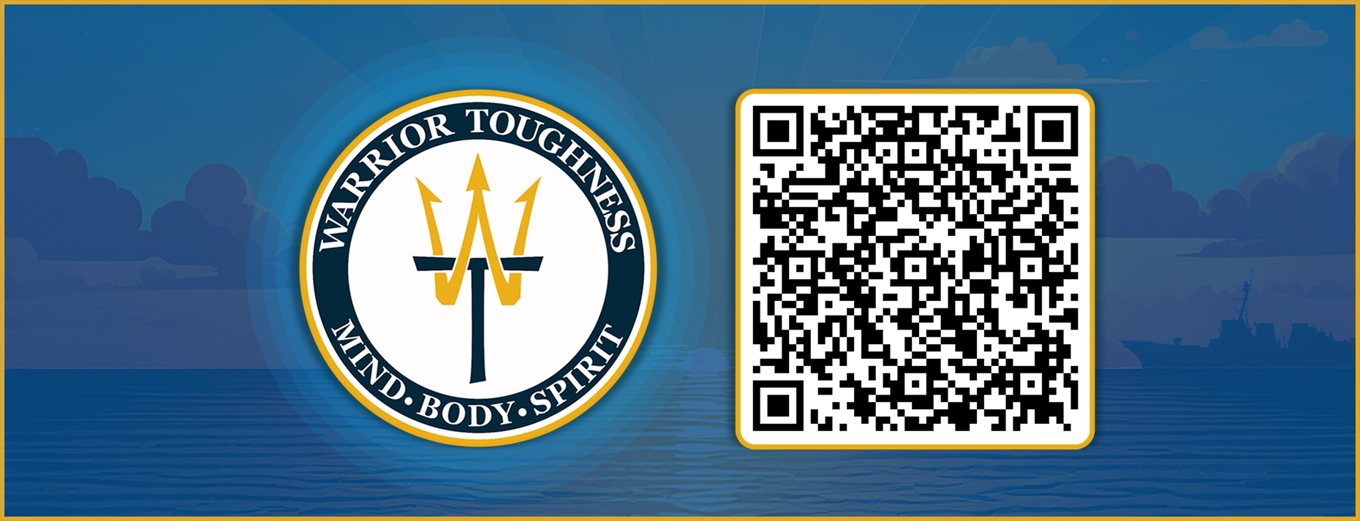
Warrior Toughness QR Code
Notes:
Facilitator Actions:
Display slide.
Facilitator Content:
Inform:
Identify Warrior Toughness QR code.

Slide 15
Glossary
Glossary
Term/ Acronym | Definition/ Term
Heuristic | Involving or serving as an aid to learning, discovery, or problem-solving by experimental and especially trial-and-error methods
WT | Warrior Toughness
Notes:
Facilitator Actions:
Display slide.
Facilitator Content: N/A

